Slide 1
Presentation
Jiayu Chen

Slide 2
Outline
Part_1: Analysis of Zaid’s Design
Part_2: My Design
Part_3: Current Results
Part_4: Next Step

Slide 3
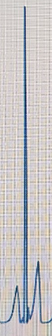
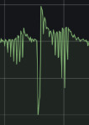
Analysis of Zaid’s Design
Initial Analysis
Zaid’s Approach:
Generate one piece of ECG signal.
Amplitude of generated ECG signal -> Motor’s average voltage, ie., 0 -> 0V, 100(R peak) -> 3.3V.
Output[n] = -Input[nT], n = 0, 1, …, T is sampling period.
The output signal approximately equals the input signal multiplied by -1 and then sampled.
The sampling rate of output is equal to the time resolution of the input signal.
R
P
T
T
P
R
Input
Output
Conclusion
Amplitude of the Received Signal
The amplitude of the output is positively proportional to the duty circle(average voltage) of the motor, but not linearly correlated.
Received signal = real signal * kernel (* is convolution). According to Zaid’s experiments, the kernel of our system should be easy.
Duty Circle
Input
Output
Notes:
Zaid 的做法
生成一段ECG信号
将ECG信号的幅度，线性映射成电压值
使用这个电压去驱动马达
左边这张图成为Input就是生成的ECG信号，右边这张图称为Output，可以很明显看到，Input和Output之间是有对应关系的，具体来说：输出信号= 输入信号 * -1 后 进行离散点的采样。
R峰最大，T峰其次，P峰最小在两张图上都是如此。
此外，可以看到Output Signal中小峰非常多，小峰的数量大致等于Input Signal中的点数量。小峰的频率=Input中的时间分辨率
有两个小结论：
接受到的信号的幅度和驱动马达的电压的大小是正相关的，但不是线性的

Slide 4
Analysis of Zaid’s Design
Further Analysis: Frequency
Outputs of Zaid’s Simulator are high frequency. The frequency of small peaks is equal to the time resolution of the generated ECG signal.
However, the number of peaks in BSG signals is around 4-9, indicating the motor should operate at a low frequency (4-9 times per heartbeat cycle) rather than the 30 times shown in the left figure.
Conclusion:
We should use the motor to simulate the heart's physical process with low-frequency pulsations, rather than driving the motor based on the generated heartbeat waveform.
Correct Process
How heart pulse?
How to operate the motor like hearts?
Are received waveforms similar to real data?
Zaid’s Process
How waveforms look like?
Operate the motor based on waveforms.
Notes:
会从频率和幅度来进一步深入分析：
Zaid的simulator的输出信号是高频的。但是我们目标的BSG信号是低频的, 4-9

Slide 5
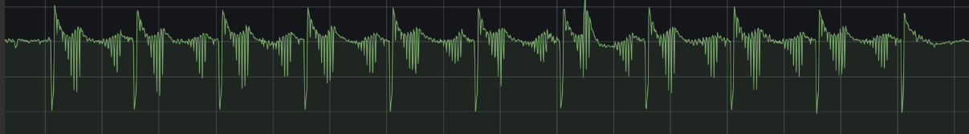
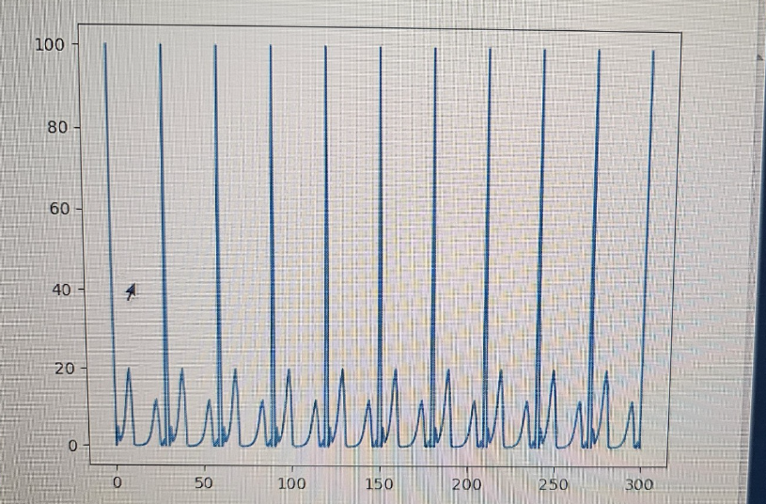
Analysis of Zaid’s Design
Further Analysis: Amplitude
Uncontrol
Control
Zaid’s Approach：the Amplitude of generated ECG signal -> Motor’s average voltage.（0 -> 0V, 100 -> 3.3V）
Disadvantages: The standardized BSG signal has both positive and negative values. However, the voltage cannot be negative, only half amplitude can be controlled.
In Zaid’s example, the portion below the yellow line is controllable, while the portion above the yellow line is uncontrolable.
Push
Push
How is the portion above the yellow line generated?
Gravity
Gravity
Below yellow line
Above yellow line
Notes:
更重要的问题其实是幅度
我上面画了一根黄线，黄线以下是Zaid可以控制的部分。黄线以上….
左边生成的信号，其实并不是ECG信号，是ECG信号的绝对值，它全部都是大于0的。为什么，因为把幅度映射成电压，你没有办法对电压取负值。
为什么会存在黄线以上的部分呢？
结论：
黄线以下的部分，可以通过改变电压大小来进行控制，黄线以上的部分，是重力导致，但是没法控制

Slide 6
Analysis of Zaid’s Design
R
P
T
T
P
R
Input
Output
Conclusion:
We should use the motor to simulate the heart's physical process with low-frequency pulsations, rather than driving the motor based on the generated heartbeat waveform.
Zaid’s approach can only control a portion of amplitude.
Zaid’s Simulator produces clear waveforms, indicating a high SNR. I should ask him how to improve the SNR.

Slide 7
My Design
PUSH
PULL
L9110
Motor
Pi
Control the motor’s low-frequency vibration by switching the polarity of the voltage at the motor pins using the L9110.
Simulating the low-frequency pulsation of a heartbeat
When the voltage polarity is reversed, the two parts of the motor will be tightly attracted, allowing control of the other half of the amplitude, rather than relying solely on gravity.

Slide 8
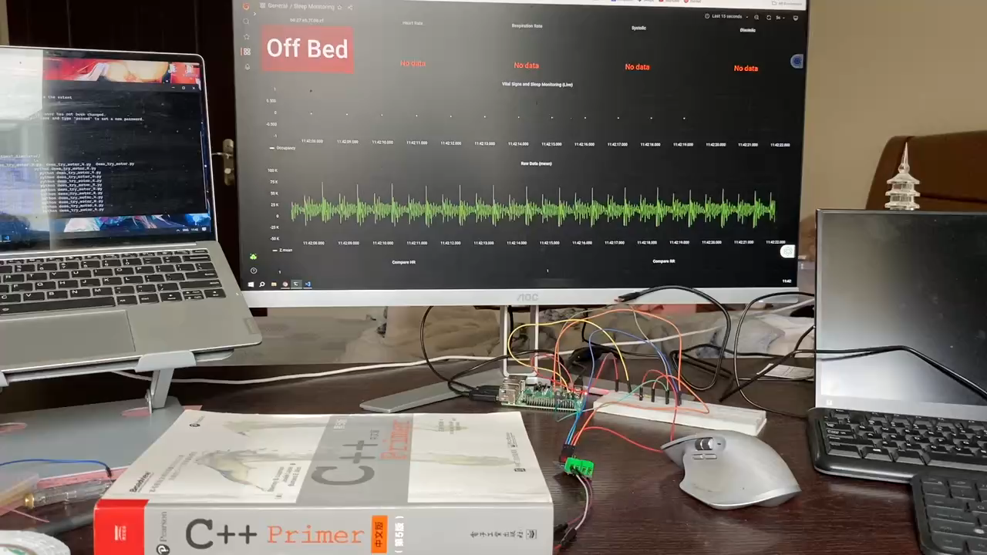
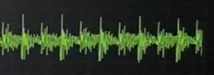
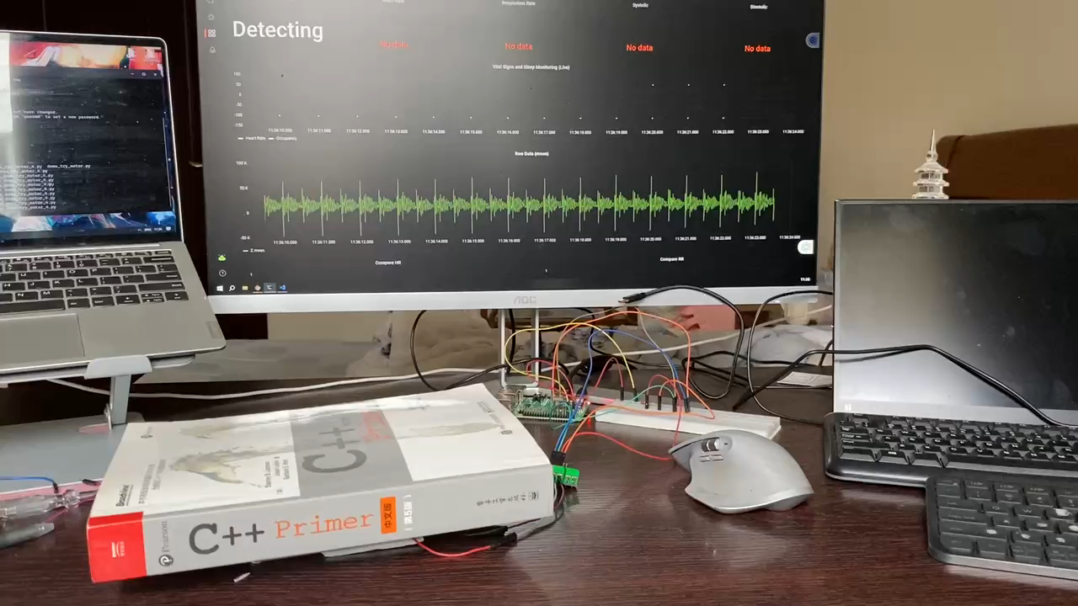
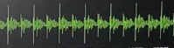
Current Results
Only the PUSH force is used, without utilizing the PULL force.
The part within the yellow box is what we control with the motor; the rest is noise.
Both PUSH and PULL forces are used.
We can use the PULL force to control the other side of the amplitude.

Slide 9
Current Results
There are many ripples. There should only be one peak(within the yellow box) caused by us. Here are two reasons:
Rigid collisions
Noise: The white noise level is 10-20K, which overlaps with the ripples.
I believe noise is the main factor.
Zaid's graph is clear, possibly due to the use of a higher-power motor. I suggest purchasing a higher-power motor to achieve better results.

Slide 10
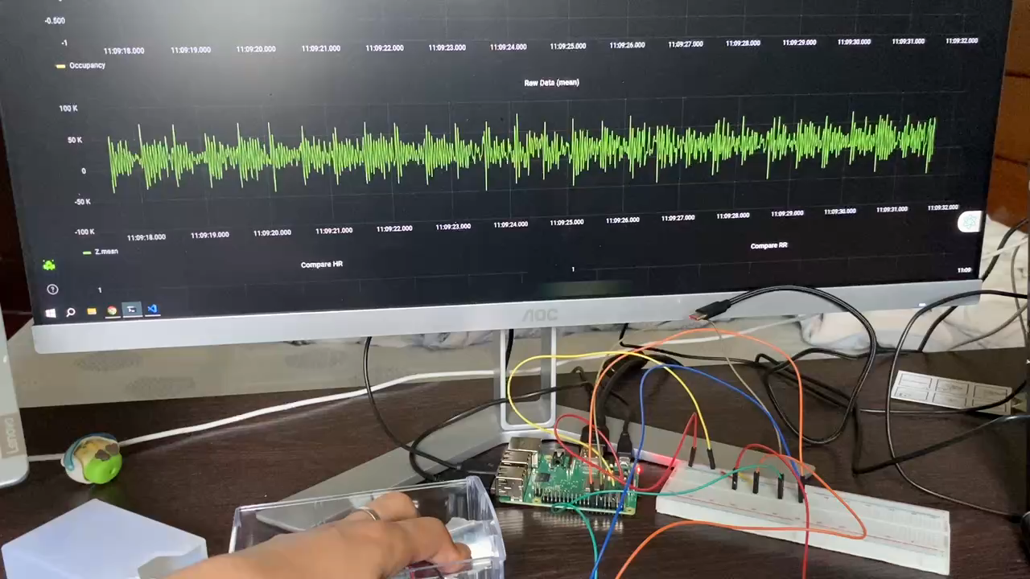
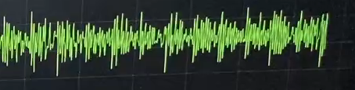
Current Results
Rigid collisions are not eliminated.
After minimizing rigid collisions as much as possible.

Slide 11
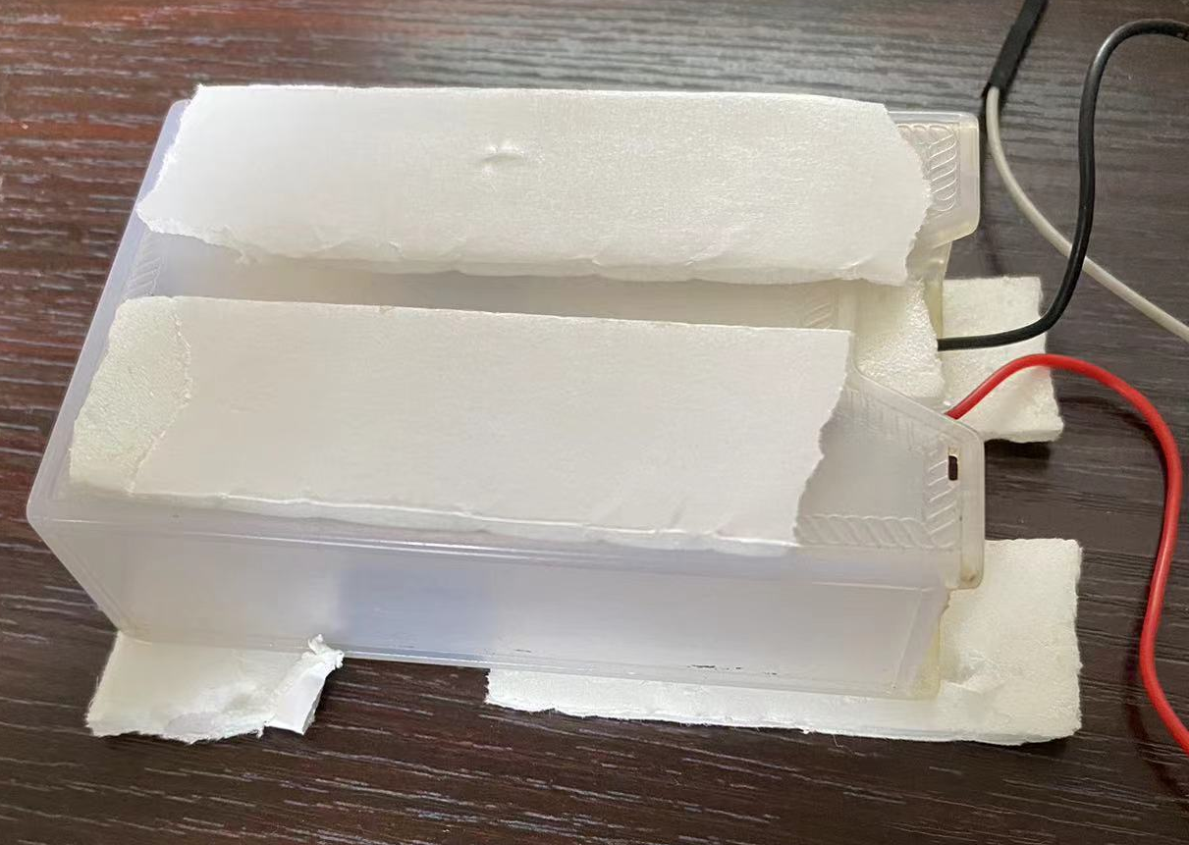
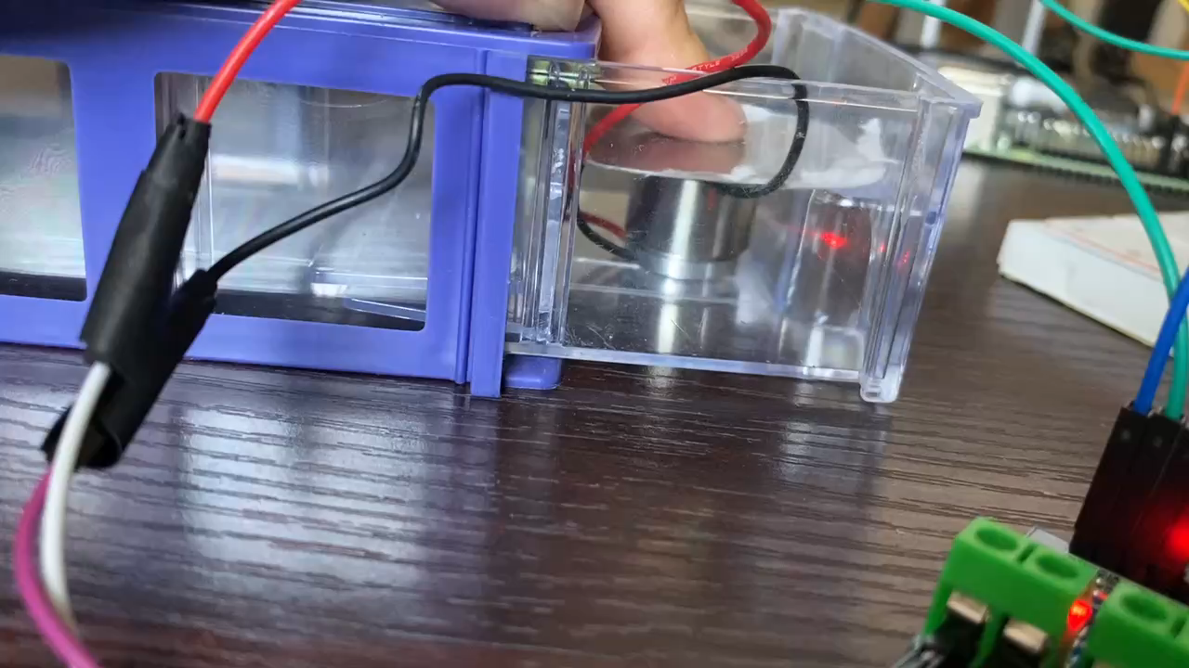
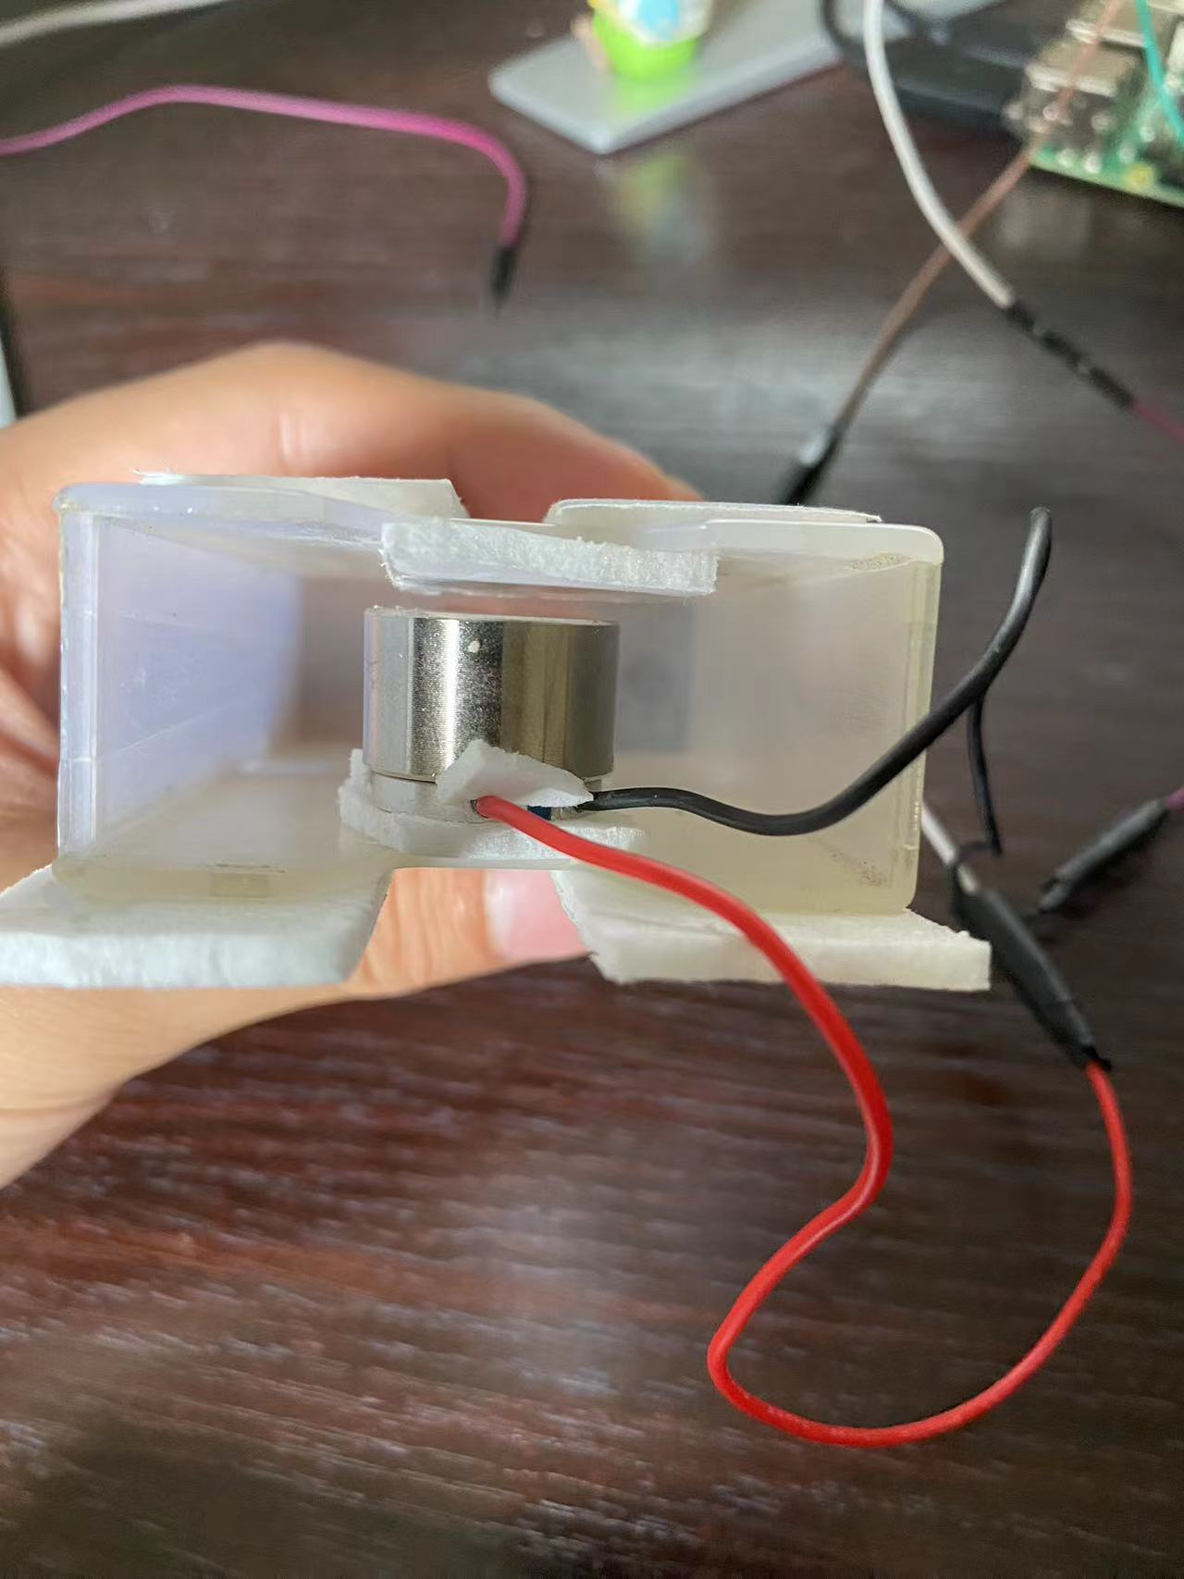

Slide 12
